Slide 1
Lecture 4
Conditionally Independent Events
Bayes’ Theorem

Slide 2
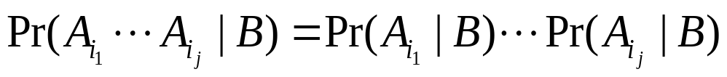
Conditionally Independent Events
A1,…,Ak are conditionally independent given B if, for every subset Ai1,…,Aij (j=2,3,…,k),
Notes:
The difference between independence and conditional independence.
Independence does not imply conditional independence.
E.g. Gender is independent of admission into school. Pr(admission and female)=Pr(admission)Pr(female). But conditional on different schools, gender may not be independent of admission.
Conditional independence does not imply independence.
E.g. Example 2.2.9.

Slide 3
Theorem Suppose that A1, A2 and B are events such that Pr(A1B)>0. Then A1 and A2 are conditionally independent given B if and only if
Pr(A2|A1B)=Pr(A2|B)

Slide 4
Question
Does conditional independence imply independence?

Slide 5
Example: Defective Items
Suppose that the probability p that the machine produces a defective item is not known, but p can be either 0.01 (normal operation) or 0.4 (needing for maintenance).
  B1: the event that p=0.01
  B2: the event that p=0.4
  Di: the event that the ith item is defective
  Conditional on B1, the events D1, D2,… are independent with Pr(Di|B1)=0.01.
  Conditional on B2, the events D1, D2,… are independent with Pr(Di|B2)=0.4.
Notes:
The difference between independence and conditional independence.
Independence does not imply conditional independence.
E.g. Gender is independent of admission into school. Pr(admission and female)=Pr(admission)Pr(female). But conditional on different schools, gender may not be independent of admission.
Conditional independence does not imply independence.
E.g. Example 2.2.9.

Slide 6
Question
Does independence imply conditional independence?

Slide 7
Example: Two Fair Coins
Flip two fair coins. Let A be the event that the first coin is head, B the event that the second coin is head. Clearly A and B are independent.
Let C be the event that the two coins are the same (both heads or both tails). A and B are not conditionally independent given C.

Slide 8
2.3 Bayes’ Theorem
Test for a Disease. Suppose that you notice that the Department of Public Health is giving a free medical test for a certain disease. The test is 90 percent reliable in the following sense: If a person has the disease, there is a probability of 0.9 that the test will give a positive response; whereas, if a person does not have the disease, there is a probability of 0.1 that the test will give a positive response. Data indicate that the prevalence of the disease is 1 in 10,000. You decide to stop and take the test. A few days later you learn that you had a positive response to the test.
What is the probability that you have the disease?

Slide 9
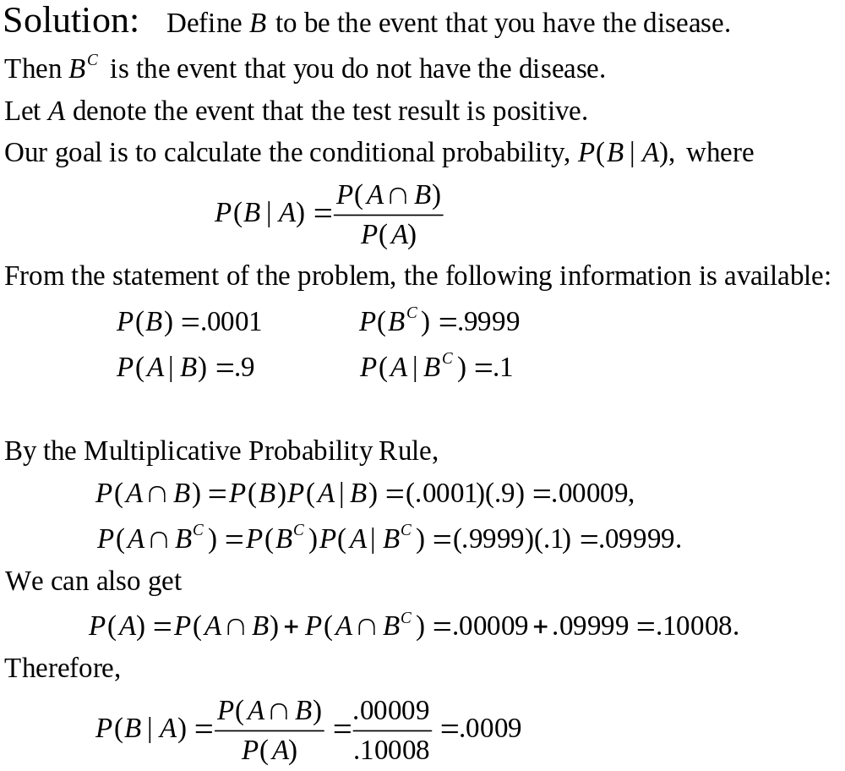

Slide 10
Bayes’ Theorem
Probability revision
Prior
Probabilities
New
Information
Bayes’
Theorem
Posterior
Probabilities
initial probability
estimates for specific
events of interest
additional information
about the events
revised
probabilities
Pr(Bi)
event A happened
Pr(A|Bi)
Pr(Bi|A)=?

Slide 11



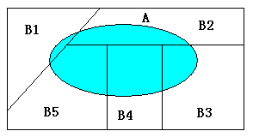
Probability and Partitions
A partition of the sample space S:
are disjoint and
A is any other event in S, we will have a partition of A:

Slide 12
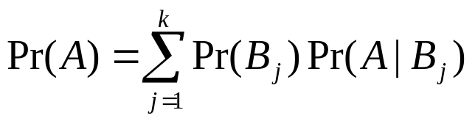
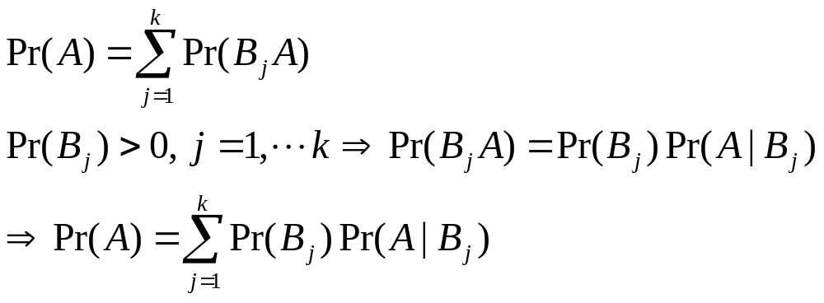
Theorem Law of total probability. Suppose that the events
B1,…,Bk form a partition of the sample space S and Pr(Bj)>0.
Then, for any event A in S,
Proof:

Slide 13
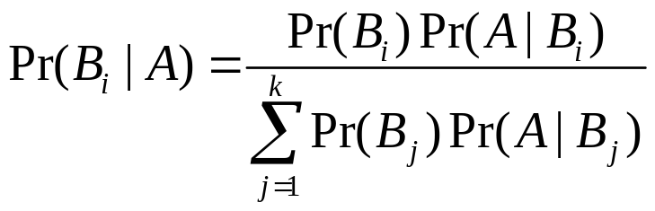
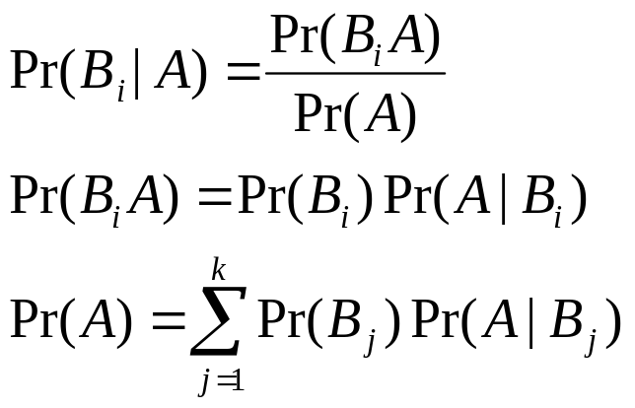
Bayes’ Theorem
Let the events B1, ...,Bk form a partition of the space S such that Pr(Bi)>0 for i=1,...,k, and let A be any event such that Pr(A)>0. Then, for i=1,...,k,
Proof.

Slide 14
Example 2.3.7 Identifying the Source of a Defective Item
Three different machines: M1, M2, M3. 20% of the items were produced by M1, 30% by machine M2, and 50% by machine M3.
1% of the items produced by M1 are defective; 2% of the items produced by M2 are defective; 3% of the items produced by M3 are defective.
One item is selected at random from the entire batch and it is found to be defective. What is the probability that this item was produced by M2?

Slide 15
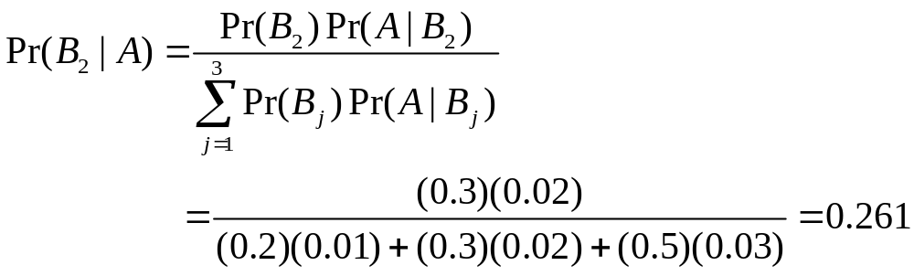
Bi: the selected item was produced by machine Mi, i=1,2,3
A: the selected item is defective
We need to calculate Pr(B2|A)
Pr(B1)=0.2, Pr(B2)=0.3, Pr(B3)=0.5
Pr(A|B1)=0.01, Pr(A|B2)=0.02, Pr(A|B3)=0.03
Notes:
Talk about the Monte Carlo example. The host has A, B, C three boxes, and one of them contains the treasure. You choose a box (e.g. A), and the host opens another box that is empty (e.g. B or C), should you switch your choice?
(1) If you stick to your original choice, the probability that you will get the treasure is Pr(A)=1/3. If you switch, the probability that you will get the treasure is Pr(B)+Pr(C)=2/3.
(2) For generality, suppose that the host opens B.
Pr(A contains the treasure|B is open and shown to be empty)
= Pr(A contains the treasure)Pr(B is open and shown to be empty|A contains the treasure)
[Pr(A contains the treasure) Pr(B is open and shown to be empty|A contains the treasure)+
Pr(B contains the treasure) Pr(B is open and shown to be empty|B contains the treasure)+
Pr(C contains the treasure) Pr(B is open and shown to be empty|A contains the treasure)]
= 1/3*1/2
1/3*1/2+1/3*0+1/3*1
=1/3
So should switch.

Slide 16
Prior and Posterior Probabilities
Pr(B2) is called the prior probability that the selected item will have been produced by machine M2.
  Before the item is selected and before it is known whether the selected item is defective or nondefective.
Pr(B2|A) is called the posterior probability that the selected item was produced by machine M2.
  After it is known that the selected item is defective.

Slide 17
Computation of Posterior Probabilities in More Than One Stage
Suppose that another item produced by the same machine as the first item is selected at random and found to be defective. What is the probability that both of these items are produced by M2?

Slide 18
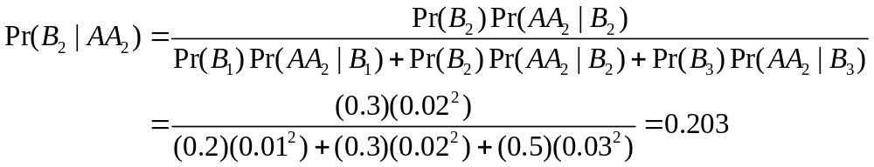
  A2: the second item is defective

Slide 19
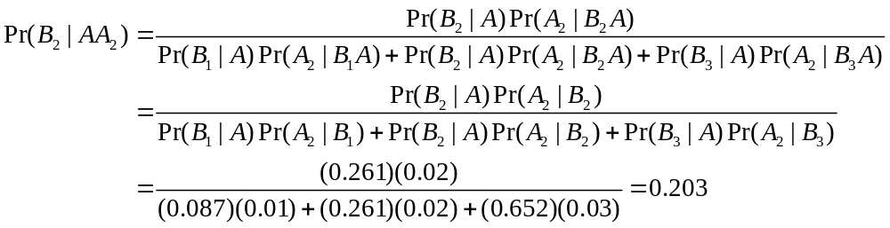
  Or, use the posterior probabilities from last stage as the prior probabilities for this stage!

Slide 20
Sequential Property
If an experiment is carried out in more than one stage, after each stage has been carried out, the posterior probability of the event found from that stage can serve as the prior probability for the next stage.
Notes:
A coherent framework for keeping updating probabilities according to new information. E.g. predict the success of future project, future operation, etc. The experience from past projects can be accumulated.

